Slide 1
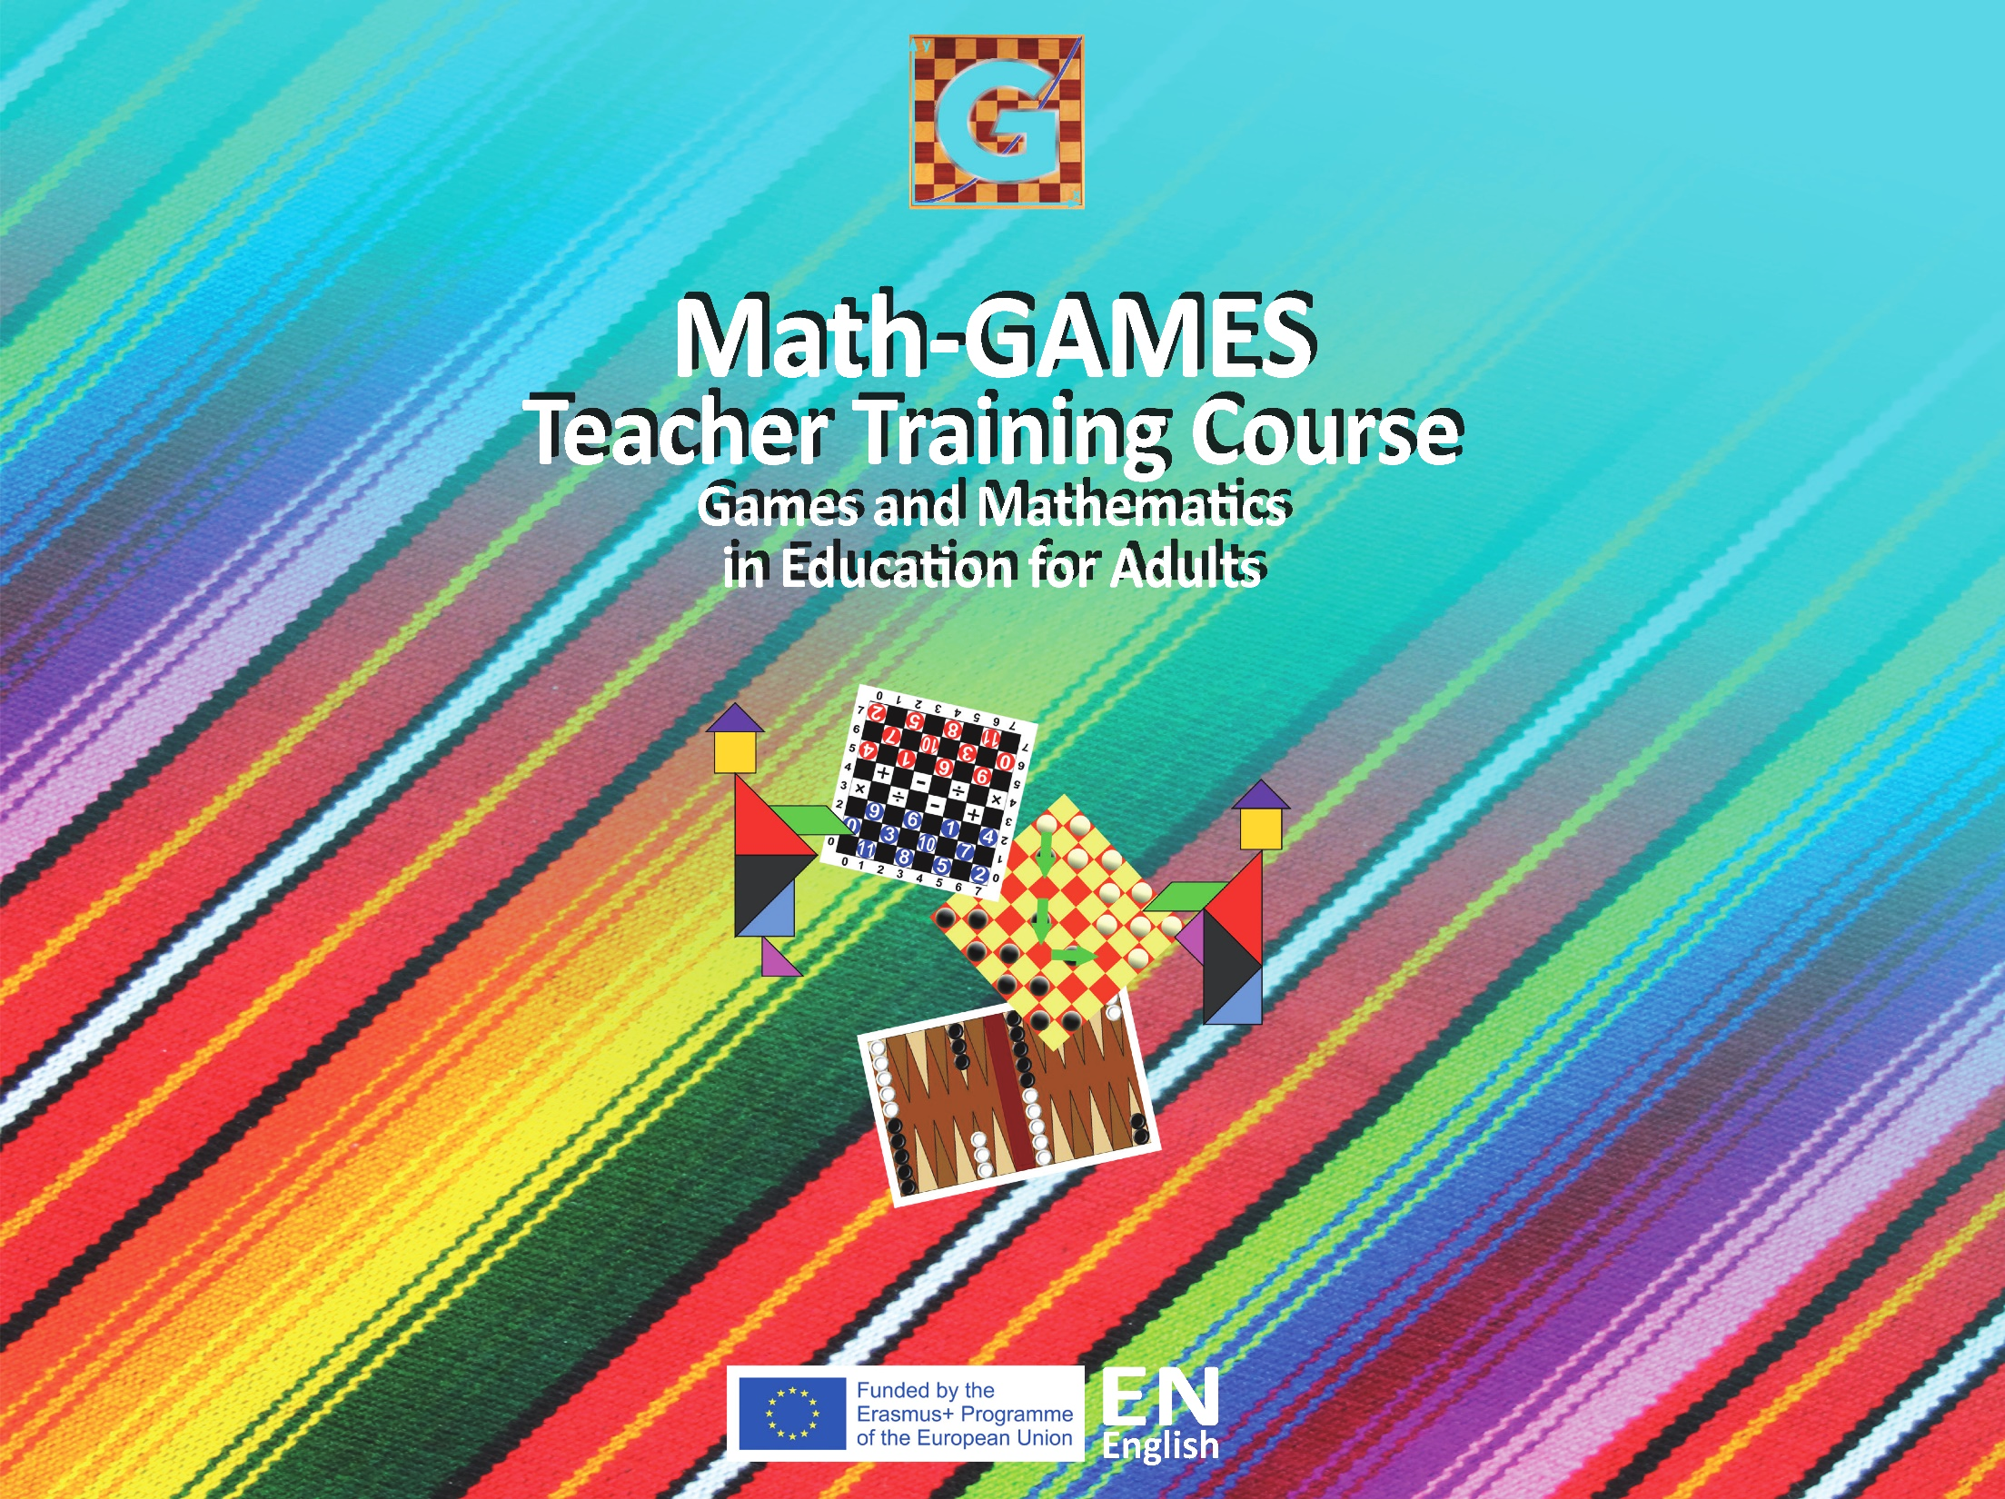

Slide 2

1.4 Tangram (Puzzle)
Objectives
The participants learn to construct a Tangram.
The students learn the geometric figures triangle, square and parallelogram.
Students learn to recognize and build geometric shapes.
Tools, Materials and Organisation
There are two possibilities:
you can construct the Tangram on a strong paper by yourself or
you copy the construction and the pupils have to use scissors to cut the figures.
The lesson takes 45 minutes.

Slide 3
1.4 Tangram (Puzzle)
Description of the Lesson
First part of the lesson (20 minutes)
Make groups of two participants. Each group has pencil, ruler, paper and scissors.
Explain the Tangram and its history
Construct the Tangram (see below, how to construct)
Second part of the lesson (25 minutes)
Give a copy of the templates with lines to the participants (easy way).
Give a copy of the templates without lines to the participants (not so easy).
Each one has to puzzle about 9 templates.
The teacher controls it and gives points to the well-done constructions.

Slide 4

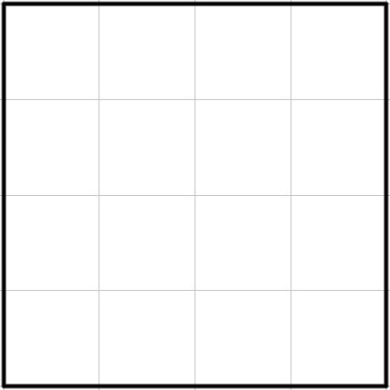




1.4 Tangram (Puzzle)
Useful Hints
How to construct a Tangram by yourself:
Draw 1 square existing of 16 small squares
Draw the diagonals like in the picture
Draw the different 7 figures of Tangram (2 small, 1 medium and 2 big triangle, 1 small square, 1 parallelogram)

Slide 5

1.4 Tangram (Puzzle)

Slide 6


1.4 Tangram

Slide 7
1.4 Tangram

Slide 8
1.4 Tangram

Slide 9
1.4 Tangram

Slide 10
1.4 Tangram

Slide 11
1.4 Tangram

Slide 12
1.4 Tangram

Slide 13
1.4 Tangram

Slide 14
1.4 Tangram

Slide 15
1.4 Tangram

Slide 16
1.4 Tangram

Slide 17
1.4 Tangram

Slide 18

1.4 Tangram

Slide 19

1.4 Tangram

Slide 20

Let’s do a puzzle!

Slide 21

Let’s do a puzzle!

Slide 22
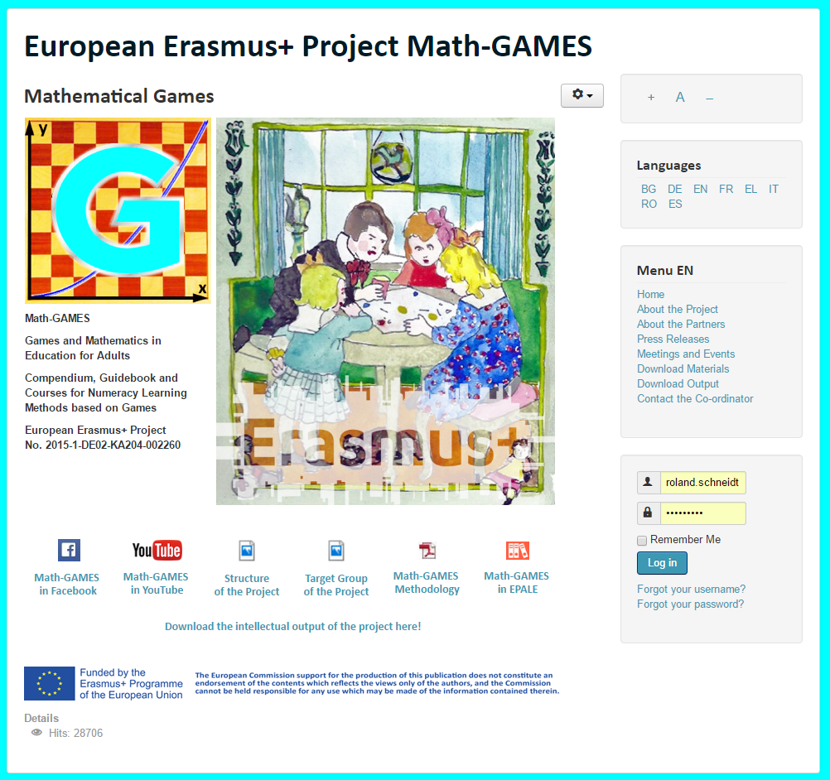
The result is: Play Games and and learn Mathematics more easily.
Our Project-Website will help you: www.math-games.eu

